Slide 1
Data Cleaning
Data Mining: Concepts and Techniques

Slide 2
Mining Data Descriptive Characteristics
For data preprocessing to be successful, it is essential to have an overall picture of the data.
Descriptive data summarization techniques can be used to identify the typical properties of data and highlight which data values should be treated as noise or outliers.
Thus, the basic concepts of descriptive data summarization is necessary for concrete workings of data preprocessing techniques.
Many data preprocessing tasks require to learn about data characteristics regarding both central tendency and dispersion of the data.
Data Mining: Concepts and Techniques

Slide 3
Mining Data Descriptive Characteristics
Motivation
  To better understand the data: central tendency, variation and spread
Data dispersion characteristics
  median, max, min, quantiles, outliers, variance, etc.
Numerical dimensions correspond to sorted intervals
  Data dispersion: analyzed with multiple granularities of precision
  Boxplot or quantile analysis on sorted intervals
Dispersion analysis on computed measures
  Folding measures into numerical dimensions
  Boxplot or quantile analysis on the transformed cube
Data Mining: Concepts and Techniques

Slide 4
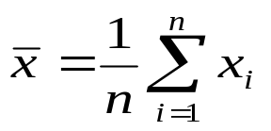

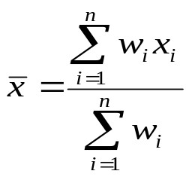
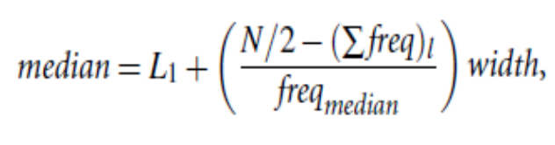
Measuring the Central Tendency
Mean (algebraic measure) (sample vs. population):
  Weighted arithmetic mean:
  Trimmed mean: chopping extreme values
Median: A holistic measure
  Middle value if odd number of values, or average of the middle two values otherwise
  Estimated by interpolation (for grouped data):
Mode
  Value that occurs most frequently in the data
  Unimodal, bimodal, trimodal
  Empirical formula:
Data Mining: Concepts and Techniques

Slide 5
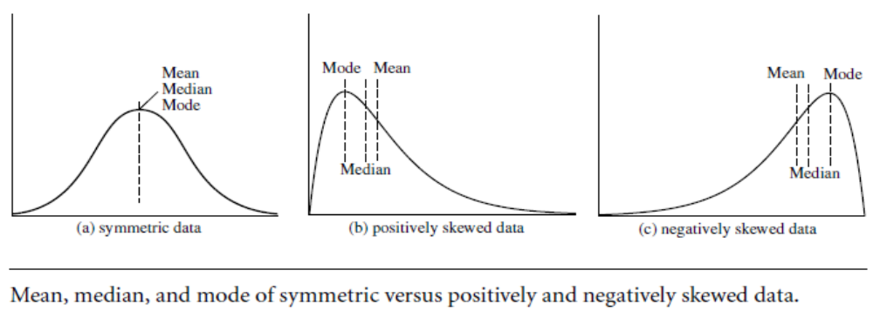
Symmetric vs. Skewed Data
Median, mean and mode of symmetric, positively and negatively skewed data
Data Mining: Concepts and Techniques

Slide 6
For skewed (asymmetric) data, a better measure of the center of data is the median.
Suppose that a given data set of N distinct values is sorted in numerical order. If N is odd, then the median is the middle value of the ordered set; otherwise (i.e., if N is even), the median is the average of the middle two values.
Data Mining: Concepts and Techniques

Slide 7

A holistic measure is a measure that must be computed on the entire data set as a whole. It cannot be computed by partitioning the given data into subsets and merging
the values obtained for the measure in each subset.
For example, people may be grouped according
to their annual salary in intervals such as 10–20K, 20–30K, and so on.
Let the interval that contains the median frequency be the median interval. We can approximate the median of the entire data set (e.g., the median salary) by interpolation using the formula:
Data Mining: Concepts and Techniques

Slide 8


Measuring the Dispersion of Data
Quartiles, outliers and boxplots
  Quartiles: Q₁ (25th percentile), Q₃ (75th percentile)
  Inter-quartile range: IQR = Q₃ – Q₁
  Five number summary: min, Q₁, M, Q₃, max
  Boxplot: ends of the box are the quartiles, median is marked, whiskers, and plot outlier individually
  Outlier: usually, a value higher/lower than 1.5 x IQR
Variance and standard deviation (sample: s, population: σ)
  Variance: (algebraic, scalable computation)
  Standard deviation s (or σ) is the square root of variance s² ⁽or σ²⁾
Data Mining: Concepts and Techniques

Slide 9
Properties of Normal Distribution Curve
The normal (distribution) curve
  From μ–σ to μ+σ: contains about 68% of the measurements (μ: mean, σ: standard deviation)
  From μ–2σ to μ+2σ: contains about 95% of it
  From μ–3σ to μ+3σ: contains about 99.7% of it
Data Mining: Concepts and Techniques

Slide 10

Boxplot Analysis
Five-number summary of a distribution:
  Minimum, Q1, M, Q3, Maximum
Boxplot
  Data is represented with a box
  The ends of the box are at the first and third quartiles, i.e., the height of the box is IRQ
  The median is marked by a line within the box
  Whiskers: two lines outside the box extend to Minimum and Maximum
Data Mining: Concepts and Techniques

Slide 11

Histogram Analysis
Graph displays of basic statistical class descriptions
  Frequency histograms
    A univariate graphical method
    Consists of a set of rectangles that reflect the counts or frequencies of the classes present in the given data
Data Mining: Concepts and Techniques

Slide 12
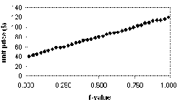
Quantile Plot
Displays all of the data (allowing the user to assess both the overall behavior and unusual occurrences)
Plots quantile information
  For a data x_{i} data sorted in increasing order, f_{i} indicates that approximately 100 f_{i}% of the data are below or equal to the value x_{i}
Data Mining: Concepts and Techniques

Slide 13
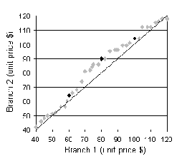
Quantile-Quantile (Q-Q) Plot
Graphs the quantiles of one univariate distribution against the corresponding quantiles of another
Allows the user to view whether there is a shift in going from one distribution to another
Data Mining: Concepts and Techniques

Slide 14
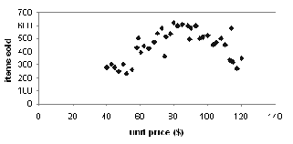
Scatter plot
Provides a first look at bivariate data to see clusters of points, outliers, etc
Each pair of values is treated as a pair of coordinates and plotted as points in the plane
Data Mining: Concepts and Techniques

Slide 15
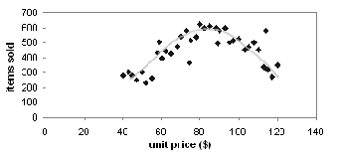
Loess Curve
Adds a smooth curve to a scatter plot in order to provide better perception of the pattern of dependence
Loess curve is fitted by setting two parameters: a smoothing parameter, and the degree of the polynomials that are fitted by the regression
Data Mining: Concepts and Techniques

Slide 16
Graphic Displays of Basic Statistical Descriptions
Histogram: (shown before)
Boxplot: (covered before)
Quantile plot: each value x_{i} is paired with f_{i} indicating that approximately 100 f_{i} % of data are ≤ x_{i}
Quantile-quantile (q-q) plot: graphs the quantiles of one univariant distribution against the corresponding quantiles of another
Scatter plot: each pair of values is a pair of coordinates and plotted as points in the plane
Loess (local regression) curve: add a smooth curve to a scatter plot to provide better perception of the pattern of dependence
Data Mining: Concepts and Techniques

Slide 17
Data Cleaning
Importance
  “Data cleaning is one of the three biggest problems in data warehousing”—Ralph Kimball
  “Data cleaning is the number one problem in data warehousing”—DCI survey
Data cleaning tasks
  Fill in missing values
  Identify outliers and smooth out noisy data
  Correct inconsistent data
  Resolve redundancy caused by data integration
Data Mining: Concepts and Techniques

Slide 18
Missing Data
Data is not always available
  E.g., many tuples have no recorded value for several attributes, such as customer income in sales data
Missing data may be due to
  equipment malfunction
  inconsistent with other recorded data and thus deleted
  data not entered due to misunderstanding
  certain data may not be considered important at the time of entry
  not register history or changes of the data
Missing data may need to be inferred.
Data Mining: Concepts and Techniques

Slide 19
How to Handle Missing Data?
Ignore the tuple: usually done when class label is missing (assuming the tasks in classification—not effective when the percentage of missing values per attribute varies considerably.
Fill in the missing value manually: tedious + infeasible?
Fill in it automatically with
  a global constant : e.g., “unknown”, a new class?!
  Use of measure of central tendency: the attribute mean, mode, median etc.
  the attribute mean for all samples belonging to the same class: smarter
  the most probable value: inference-based such as Bayesian formula or decision tree
Data Mining: Concepts and Techniques

Slide 20
Noisy Data
Noise: random error or variance in a measured variable
Incorrect attribute values may due to
  faulty data collection instruments
  data entry problems
  data transmission problems
  technology limitation
  inconsistency in naming convention
Other data problems which requires data cleaning
  duplicate records
  incomplete data
  inconsistent data
Data Mining: Concepts and Techniques

Slide 21
How to Handle Noisy Data?
Binning
  first sort data and partition into (equal-frequency) bins
  then one can smooth by bin means, smooth by bin median, smooth by bin boundaries, etc.
Regression
  smooth by fitting the data into regression functions
Clustering
  detect and remove outliers
Combined computer and human inspection
  detect suspicious values and check by human (e.g., deal with possible outliers)
Data Mining: Concepts and Techniques

Slide 22
Simple Discretization Methods: Binning
Equal-width (distance) partitioning
  Divides the range into N intervals of equal size: uniform grid
  if A and B are the lowest and highest values of the attribute, the width of intervals will be: W = (B –A)/N.
  The most straightforward, but outliers may dominate presentation
  Skewed data is not handled well
Equal-depth (frequency) partitioning
  Divides the range into N intervals, each containing approximately same number of samples
  Good data scaling
  Managing categorical attributes can be tricky
Data Mining: Concepts and Techniques

Slide 23
Binning Methods for Data Smoothing
Sorted data for price (in dollars): 4, 8, 9, 15, 21, 21, 24, 25, 26, 28, 29, 34
* Partition into equal-frequency (equi-depth) bins:
- Bin 1: 4, 8, 9, 15
- Bin 2: 21, 21, 24, 25
- Bin 3: 26, 28, 29, 34
* Smoothing by bin means:
- Bin 1: 9, 9, 9, 9
- Bin 2: 23, 23, 23, 23
- Bin 3: 29, 29, 29, 29
* Smoothing by bin boundaries:
- Bin 1: 4, 4, 4, 15
- Bin 2: 21, 21, 25, 25
- Bin 3: 26, 26, 26, 34
Data Mining: Concepts and Techniques

Slide 24
Regression
y
Y1
Y1’
y = x + 1
X1
x
Data Mining: Concepts and Techniques

Slide 25
Definition of Regression
A regression is a statistical analysis assessing the association between two variables.
It is used to find the relationship between two variables.
Regression Formula:
Regression Equation(y) = a + bx
Slope(b) = (NΣXY - (ΣX)(ΣY)) / (NΣX² - (ΣX)²)
Intercept(a) = (ΣY - b(ΣX)) / N
Data Mining: Concepts and Techniques

Slide 26
Contd…
where
x and y are the variables.
b = The slope of the regression line
a = The intercept point of the regression line and the y axis.
N = Number of values or elements
X = First Score
Y = Second Score
ΣXY = Sum of the product of first and Second Scores
ΣX = Sum of First Scores
ΣY = Sum of Second Scores
ΣX² = Sum of square First Scores
Data Mining: Concepts and Techniques

Slide 27
Regression Example
To find the Simple/Linear Regression of
X Values | Y Values
60 | 3.1
61 | 3.6
62 | 3.8
63 | 4
65 | 4.1
Solution
Data Mining: Concepts and Techniques

Slide 28
Cluster Analysis
Data Mining: Concepts and Techniques

Slide 29
Discrepancy detection
Discrepancies can be caused by several factors
Poorly designed data entry forms that have many optional fields
Human error in data entry, deliberate errors (e.g., respondents not wanting to tell information about themselves)
Data decay (e.g., outdated addresses)
Inconsistent data representations and Inconsistent use of codes (such as “2004/12/25” and “25/12/2004” for date).
Errors in instrumentation devices that record data, and system errors
Inconsistencies due to data integration (e.g., where a given attribute can have different names in different databases).
Data Mining: Concepts and Techniques

Slide 30
Data Cleaning as a Process
Data discrepancy detection
  Use metadata (e.g., domain, range, dependency, distribution)
  Metadata → data about data
Check field overloading
  when developers squeeze new attribute definitions into unused (bit) portions of already defined attributes (e.g., using an unused bit of an attribute whose value range uses only, say, 31 out of 32 bits).
Data Mining: Concepts and Techniques

Slide 31
Contd…
Check uniqueness rule, consecutive rule and null rule
  A unique rule says that each value of the given attribute must be different from all other values for that attribute.
  A consecutive rule says that there can be no missing values between the lowest and highest values for the attribute, and that all values must also be unique (e.g., as in check numbers).
  A null rule specifies the use of blanks, question marks, special characters, or other strings that may indicate the null condition (e.g., where a value for a given attribute is not available), and how such values should be handled
Data Mining: Concepts and Techniques

Slide 32
Contd…
Use commercial tools
    Data scrubbing: use simple domain knowledge (e.g., postal code, spell-check) to detect errors and make corrections
    Data auditing: by analyzing data to discover rules and relationship to detect violators (e.g., correlation and clustering to find outliers)
Data migration and integration
  Data migration tools: allow transformations to be specified (to replace the string “gender” by “sex”)
  ETL (Extraction/Transformation/Loading) tools: allow users to specify transformations through a graphical user interface
Integration of the two processes
  Iterative and interactive (e.g., Potter’s Wheels)
Data Mining: Concepts and Techniques

